Slide 1
Program Control
“You've got to know when to hold 'em, know when to fold 'em, know when to walk away, know when to run…”
– Kenny Rodgers
Based on slides created for COP3502 by Dr. Jeremiah Blanchard
Modified by Fernando J. Rodríguez

Slide 2
Sequential Execution
Start
01 02 03 04 05 06 07 08 09 10 11 12 13 14 15 16 17 18
import java.util.Scanner;
public class Division
{
public static void main(String[] args)
{
Scanner myScanner = new Scanner(System.in);
System.out.print("Enter dividend: ");
int dividend = myScanner.nextInt();
System.out.print("Enter divisor: ");
int divisor = myScanner.nextInt();
System.out.println("The quotient is " + (dividend / divisor));
}
}
OUTPUT:
Declare Scanner
Enter dividend: 24
Enter divisor: 0
...
X_X
Prompt for dividend, store in variable
Prompt for divisor, store in variable
Perform division
Print result
End

Slide 3
If Statement
if statement: executes a statement or group of statements if a given condition is true; skips the statements if the condition is false
if (<condition>)
{
<statements>
}
condition
false
true
statements

Slide 4












Selection: If Statement
Selection is a type of branching where the program selects one course of action.
01 02 03 04 05 06 07 08 09 10 11 12 13 14 15 16 17 18
import java.util.Scanner;
public class NumberGuessingGame
{
public static void main(String[] args)
{
Scanner myScanner = new Scanner(System.in);
// Print a greeting and read in a number.
System.out.print("Try to guess my number!\nWhat's your guess? ");
int guess = myScanner.nextInt();
if (guess == 10)
System.out.println("Wow, you must be psychic!");
System.out.println("See ya later!");
}
}
OUTPUT:
Try to guess my number!
What’s your guess? 10
Wow, you must be psychic!
See ya later!
OUTPUT:
Try to guess my number!
What’s your guess? 5
See ya later!

Slide 5
Selection: If Block
We often use a block to represent multiple statements as one.
01 02 03 04 05 06 07 08 09 10 11 12 13 14
public class PortalFun
{
public static void main(String[] args)
{
long universe = Math.round(Math.random() * 500.0);
if (universe > 300)
{
System.out.println("Alright! We found C" + universe + "!");
System.out.println("Time to get schwifty!");
}
System.out.println("Time to get going..");
}
}
OUTPUT:
Alright! We found C500!
Time to get schwifty!
Time to get going.
OUTPUT:
Time to get going.

Slide 6
If-else Statement
if-else statement: executes one block if a given condition is true and executes the other block if the condition is false
if (<condition>)
{
<block_1>
}
else
{
<block_2>
}
condition
false
true
block_1
block_2

Slide 7
If-else Example
01 02 03 04 05 06 07 08 09 10 11 12 13 14 15 16 17 18 19 20 21 22 23 24
import java.util.Scanner;
public class Division
{
public static void main(String[] args)
{
Scanner myScanner = new Scanner(System.in);
System.out.print("Enter dividend: ");
int dividend = myScanner.nextInt();
System.out.print("Enter divisor: ");
int divisor = myScanner.nextInt();
if (divisor == 0)
{
System.out.println("Do not divide by zero!");
}
else
{
System.out.println("The quotient is " + (dividend / divisor));
}
}
}
OUTPUT:
Enter dividend: 24
Enter divisor: 0
Do not divide by zero!
OUTPUT:
Enter dividend: 24
Enter divisor: 6
The quotient is 4

Slide 8
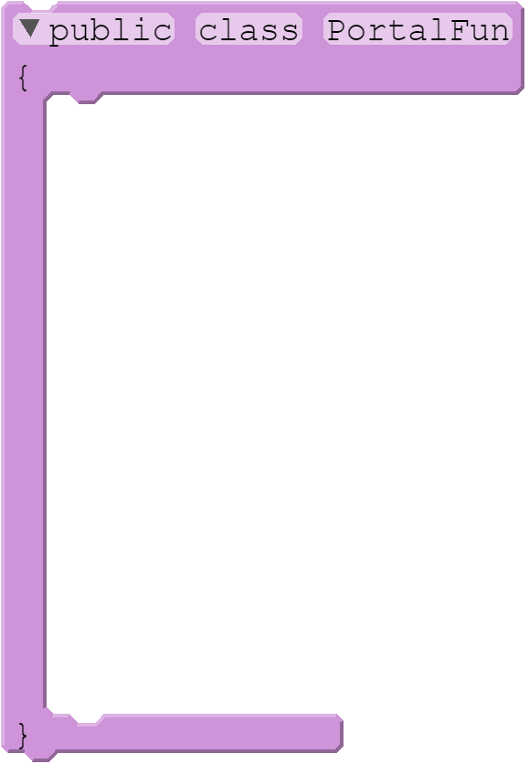
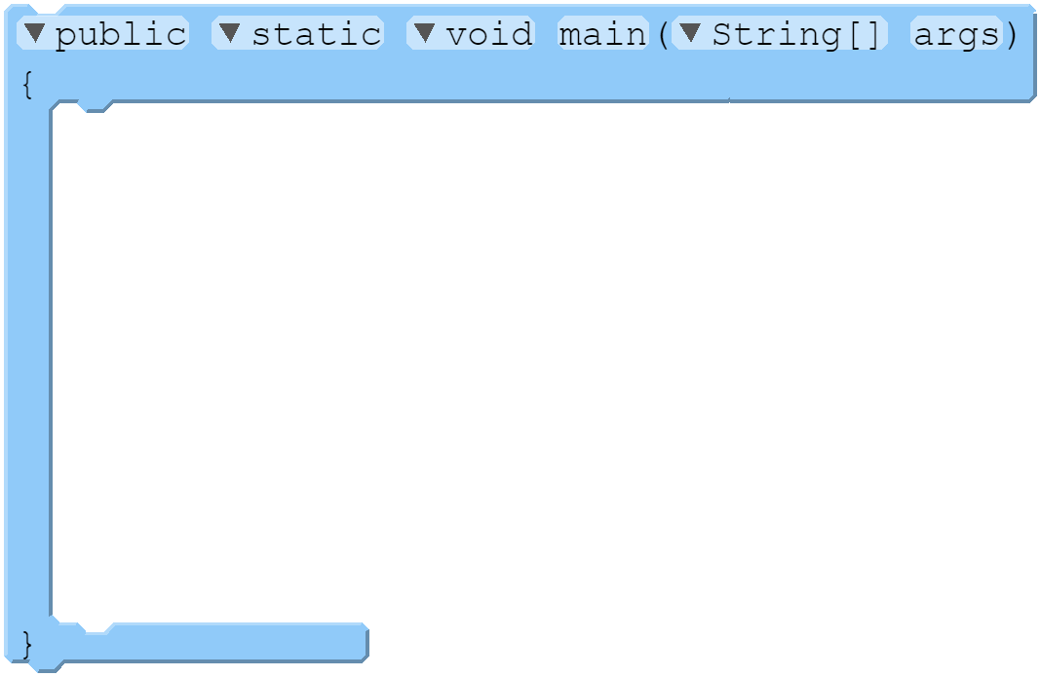
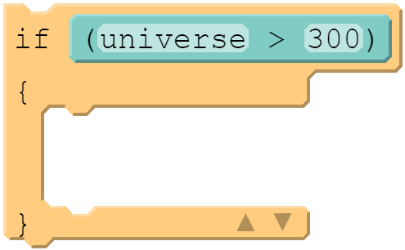
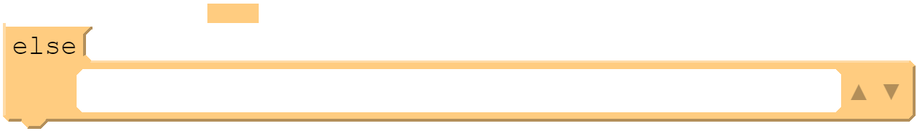
Selection: If / ELSE
If we have several options, we can compare them one after another.
01 02 03 04 05 06 07 08 09 10 11 12 13 14 15
public class PortalFun
{
public static void main(String[] args)
{
long universe = Math.round(Math.random() * 600.0);
if (universe > 300)
{
System.out.println("Alright! We found C" + universe + "!");
System.out.println("Time to get schwifty!");
}
else
System.out.println("Ugh. This is terrible.");
}
}
OUTPUT:
Alright! We found C501!
Time to get schwifty!
OUTPUT:
Ugh. This is terrible.

Slide 9
Practice
Write a program that asks the user for an integer and prints out whether the integer is even or odd
Sample output #1
Enter an integer: 42
42 is an even number.
Sample output #2
Enter an integer: 17
17 is an odd number.

Slide 10
Program Control
“You've got to know when to hold 'em, know when to fold 'em, know when to walk away, know when to run…”
– Kenny Rodgers
Based on slides created for COP3502 by Dr. Jeremiah Blanchard
Modified by Fernando J. Rodríguez

Slide 11
Relational Operators
Relational operators let us compare two values.
Evaluating relational expressions results in a boolean value (true or false)
Name | Op | Example | Value
Less than | < | 5 < 5 | false
Greater than | > | 6 > 3 | true
Less than or equal to | <= | 3 <= 3 | true
Greater than or equal to | >= | 6 >= 7 | false
Equal to | == | 10 == 10 | true
Not Equal to | != | 10 != 9 | true
NOTE:
= and == are not the same
= is used for assignment
== is used to compare two values

Slide 12
Question
int num = 3;
// check whether num is in the range [1, 100]
if (1 < num < 100)
System.out.println("num is in the range.");
else
System.out.println("num is not in the range");
int num = 3;
// check whether num is in the range [1, 100]
if (1 < num && num < 100)
System.out.println("num is in the range.");
else
System.out.println("num is not in the range");
What is the output of the above program?
num is in the range
num is not in the range
Syntax Error

Slide 13
Special Cases for Comparisons
Characters can be directly compared (Unicode numbers are compared)
‘a’ == ‘a’, but ‘a’ != ‘A’
Strings are Objects and CANNOT be compared with relational operators
Use the equals and compareTo methods instead (discussed in a future module)
String message = “Hello”;
boolean sameStrings = message.equals(“Hello”);
Floating point numbers are approximated and difficult to compare directly
Define a threshold and compare the difference between two values
final THRESHOLD = 0.0001;
double x = 0.1 + 0.1 + 0.1 + 0.1 + 0.1 + 0.1;
double y = 0.1 * 6;
boolean sameNumbers = Math.abs(x – y) < THRESHOLD;

Slide 14
Logical Operators
Using logical operators, we can manipulate and/or combine relational expressions.
Evaluating relational expressions results in a boolean value (true or false)
Name | Op | Function | Example | Value
NOT | ! | Value is opposite operand’s value | !(4 > 3) !(3 > 4) | false true
AND | && | True if both sides are true | 4 > 3 && 2 > 3 4 > 3 && 3 > 2 3 > 4 && 2 > 3 | false true false
OR | || | True if either side is true (or both) | 4 > 3 || 2 > 3 4 > 3 || 3 > 2 3 > 4 || 2 > 3 | true true false

Slide 15
Truth Tables for LogiCal OperaTors
In these tables, x and y are boolean variables
NOT
AND
OR
x | !x
true | false
false | true
x | y | x && y
true | true | true
true | false | false
false | true | false
false | false | false
x | y | x || y
true | true | true
true | false | true
false | true | true
false | false | false
The expression evaluates to the opposite of the original boolean value
If one of the operands is false, the expression evaluates to false
If one of the operands is true, the expression evaluates to true

Slide 16
Precedence of All Operators
Among all operators, there is defined precedence:
Operators | Precedence
() | 1
! | 2
*, /, % | 3
+, - | 4
<, <=, >, >= | 5
==, != | 6
&& | 7
|| | 8

Slide 17
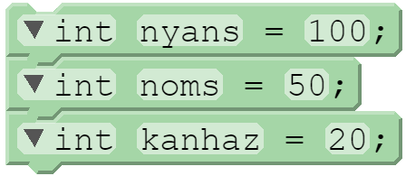

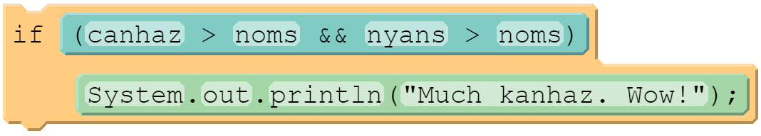
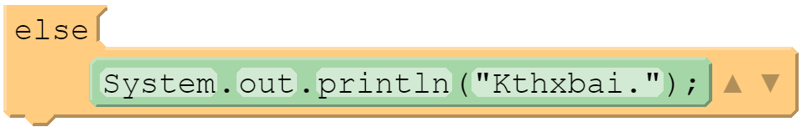
Short-Circuit Evaluation
In Java (and most C-family languages), conditionals are evaluated only when needed. This is referred to as short circuit evaluation.
01 02 03 04 05 06 07 08
int nyans = 100;
int noms = 50;
int kanhaz = 20;
if (canhaz > noms && nyans > noms)
System.out.println("Much kanhaz. Wow!");
else
System.out.println("Kthxbai.");
Evaluates to “false”
Never evaluated!

Slide 18
Practice
Evaluate the following boolean expressions, assuming the following:
int x = 42;
int y = 17;
int z = 25;
y < x && y <= z
x % 2 == y % 2 || x % 2 == z % 2
x <= y + z && x >= y + z
!(x < y && x < z)
(x + y) % 2 == 0 || !((z – y) % 2 == 0)

Slide 19
Practice
int x = 42;
int y = 17;
int z = 25;
y < x && y <= z
(y < x) && (y <= z)
(17 < 42) && (17 <= 25)
(true) && (true)
true

Slide 20
Practice
int x = 42;
int y = 17;
int z = 25;
x % 2 == y % 2 || x % 2 == z % 2
((x % 2) == (y % 2)) || ((x % 2) == (z % 2))
((42 % 2) == (17 % 2)) || ((42 % 2) == (25 % 2))
((0) == (1)) || ((0) == (1))
(false) || (false)
false

Slide 21
Practice
int x = 42;
int y = 17;
int z = 25;
x <= y + z && x >= y + z
(x <= (y + z)) && (x >= (y + z))
(42 <= (17 + 25)) && (42 >= (17 + 25))
(42 <= (42)) && (42 >= (42))
(true) && (true)
true

Slide 22
Practice
int x = 42;
int y = 17;
int z = 25;
!(x < y && x < z)
!((x < y) && (x < z))
!((42 < 17) && (42 < 25))
!((false) && (false))
!(false)
true

Slide 23
Practice
int x = 42;
int y = 17;
int z = 25;
(x + y) % 2 == 0 || !((z – y) % 2 == 0)
(((x + y) % 2) == 0) || !((z – y) % 2 == 0)
(((42 + 17) % 2) == 0) || !(((25 – 17) % 2) == 0)
(((59) % 2) == 0) || !(((8) % 2) == 0)
((1) == 0) || !((0) == 0)
(false) || !(true)
(false) || false
false

Slide 24
Program Control
“You've got to know when to hold 'em, know when to fold 'em, know when to walk away, know when to run…”
– Kenny Rodgers
Based on slides created for COP3502 by Dr. Jeremiah Blanchard
Modified by Fernando J. Rodríguez

Slide 25
If-else if Statements
if-else statements can be chained one after the other to evaluate multiple conditions
if (<condition_1>)
{
<block_1>
}
else if (<condition_2>)
{
<block_2>
}
else
{
<block_3>
}
false
condition_1
false
condition_2
true
true
block_1
block_2
block_3

Slide 26
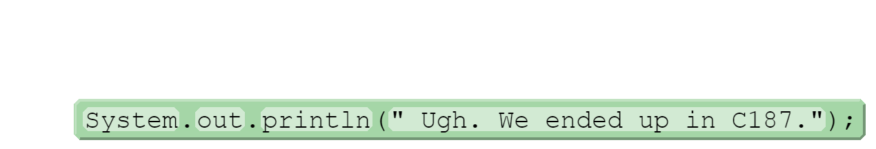
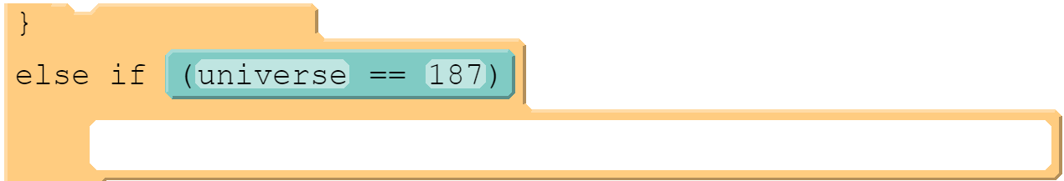
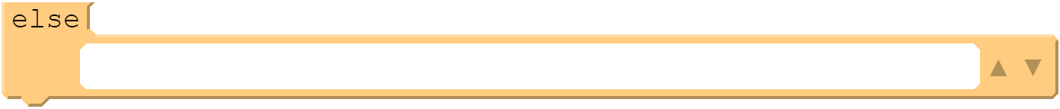
Selection: If / ELSE CHAINING
If we have several options, we can compare them one after another.
01 02 03 04 05 06 07 08 09 10 11 12 13 14 15 16 17
public class PortalFun
{
public static void main(String[] args)
{
long universe = Math.round(Math.random() * 600.0);
if (universe > 300)
{
System.out.println("Alright! We found C" + universe + "!");
System.out.println("Time to get schwifty!");
}
else if (universe == 187)
System.out.println(" Ugh. We ended up in C187.");
else
System.out.println("At least we’re not in C187.");
}
}
OUTPUT:
Alright! We found C501!
Time to get schwifty!
OUTPUT:
Ugh. We ended up in C187.
OUTPUT:
At least we’re not in C187.

Slide 27
Selection: If / ELSE Nesting
We can also nest a selection inside of another.
01 02 03 04 05 06 07 08 09 10 11 12 13 14 15 16 17
public class PortalFun
{
public static void main(String[] args)
{
long universe = Math.round(Math.random() * 600.0);
if (universe > 300)
System.out.println("C" + universe + "! Time to get schwifty!");
else
{
if (universe == 187)
System.out.println(" Ugh. We ended up in C187.");
else
System.out.println("At least we’re not in C187.");
}
}
}
OUTPUT:
C502! Time to get schwifty!
OUTPUT:
Ugh. We ended up in C187.
OUTPUT:
At least we’re not in C187.

Slide 28
Question
if (magnitude >= 0)
if (magnitude <= 4)
System.out.println("The earthquake is harmless");
else
System.out.println("Negative value not allowed");
Predict the output when
magnitude = 3
magnitude = 7
if (magnitude >= 0)
{
if (magnitude <= 4)
System.out.println("The earthquake is harmless");
}
else
System.out.println("Negative value not allowed");
Predict the output when
magnitude = 3 Output: The earthquake is harmless
magnitude = 7 Output: Negative value not allowed

Slide 29
Sequential If Statements
if-else statements can be chained one after the other to evaluate multiple conditions
if (<condition_1>)
{
<block_1>
}
if (<condition_2>)
{
<block_2>
}
if (<condition_3>)
{
<block_3>
}
true
block_1
condition_1
false
true
condition_2
block_2
false
true
condition_3
block_3
false

Slide 30
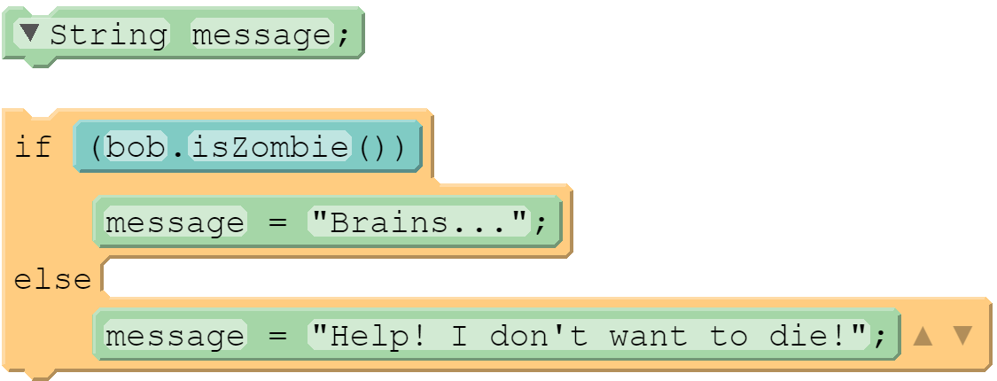
Conditional / Ternary Operator
Sometimes we want to quickly determine a value by doing a quick check.
We can do this more efficiently with the ternary operator (conditional expression).
<condition> ? <value_if_true> : <value_if_false>;
01 02 03 04 05 06
String message;
if (bob.isZombie())
message = "Brains...";
else
message = "Help! I don't want to die!";
01
String message = bob.isZombie() ? "Brains..." : "Help! I don't want to die!";

Slide 31
Switch Statement
switch statement: compares a single variable to multiple values
switch (<variable>)
{
case <value_1>:
<block_1>
break;
case <value_2>:
<block_2>
break;
...
default:
<block_default>
}
variable == value_1
false
variable == value_2
false
true
. . .
true
block_1
block_2
block_default

Slide 32
Switch Statements
A switch statement allows us to check a single variable against multiple values:
01 02 03 04 05 06 07 08 09 10 11 12 13 14 15 16 17 18 19 20
switch (numberOfWheels)
{
case 0:
System.out.println("You have these things called 'feet'.");
break;
case 1:
System.out.println("You're riding a unicycle!");
break;
case 2:
System.out.println("You've got a bike. Is it motor powered?");
break;
case 3:
System.out.println("You're riding a tricycle. How cute!");
break;
case 4:
System.out.println("Four-wheeler. Now you're driving for real!");
break;
default:
System.out.println("WAT.");
}
break statement:
Used to exit a switch statement
If it is left out, the program ”falls through” the remaining statements in the switch statement

Slide 33
Practice
Write a program that asks the user for an integer and prints out whether the integer is divisible by 2, 3, and/or 5. The program should also print if it is not divisible by any of these numbers
Sample output #1
Enter an integer: 42
42 is divisible by 2.
42 is divisible by 3.
Sample output #2
Enter an integer: 17
17 is not divisible by 2, 3, or 5.

Slide 34
Program Control
“You've got to know when to hold 'em, know when to fold 'em, know when to walk away, know when to run…”
– Kenny Rodgers
Based on slides created for COP3502 by Dr. Jeremiah Blanchard
Modified by Fernando J. Rodríguez

Slide 35
Limitations to if statements
if statements and other conditional statements can only check conditions once.
01 02 03 04 05 06 07 08 09 10 11 12 13 14 15 16 17 18
Solution: loops!
OUTPUT:
import java.util.Scanner;
public class NumberGuessingGame
{
public static void main(String[] args)
{
Scanner myScanner = new Scanner(System.in);
// Print a greeting and read in a number.
System.out.print("Try to guess my number!\nWhat's your guess? ");
int guess = myScanner.nextInt();
if (guess == 10)
System.out.println("Wow, you must be psychic!");
System.out.println("See ya later!");
}
}
Try to guess my number!
What’s your guess? 10
Wow, you must be psychic!
See ya later!
OUTPUT:
Try to guess my number!
What’s your guess? 5
See ya later!

Slide 36
While Loops
while loops: executes a statement or group of statements as long as a given condition is true; exits the loop once the condition is false
while (<condition>)
{
<statements>
}
condition
false
true
statements

Slide 37

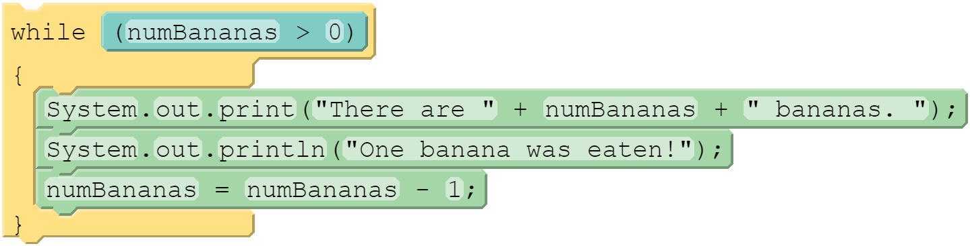
While Loops
A loop can be used to repeat a group of statements:
05 06 07 08 09 10 11 12 13 14
int numBananas = 3;
while (numBananas > 0)
{
System.out.print("There are " + numBananas + " bananas. ");
System.out.println("One banana was eaten!");
numBananas = numBananas - 1;
}
System.out.println("Yes, we have no bananas.");
Values
numBananas
numBananas > 0
3
2
1
0
true
false
OUTPUT:
There are 3 bananas.
There are 2 bananas.
There are 1 bananas.
Yes, we have no bananas.
One was eaten!
One was eaten!
One was eaten!
A loop with only a condition (no other parameters) is called a while loop.

Slide 38
Beware Infinite Loops
If the condition is always true, the program will continue to execute the block statements.
05 06 07 08 09 10 11 12 13 14
int numBananas = 3;
while (numBananas > 0)
{
System.out.print("There are " + numBananas + " bananas. ");
System.out.println("One banana was eaten!");
numBananas = numBananas + 1;
}
System.out.println("Yes, we have no bananas.");
OUTPUT:
There are 3 bananas. One was eaten!
There are 4 bananas. One was eaten!
There are 5 bananas. One was eaten!
There are 6 bananas. One was eaten!
There are 7 bananas. One was eaten!
There are 8 bananas. One was eaten!
There are 9 bananas. One was eaten!
There are 10 bananas. One was eaten!
...
Make sure your control variable is updated properly.

Slide 39
Do-While Loops
do-while loops: a variation of the while loop that guarantees the statement or group of statements in the block will be executed at least once
do
{
<statements>
}
while (<condition>);
statements
true
condition
false

Slide 40

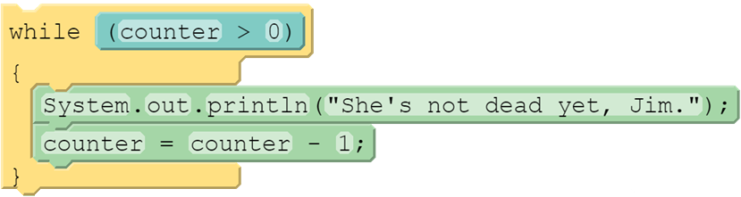
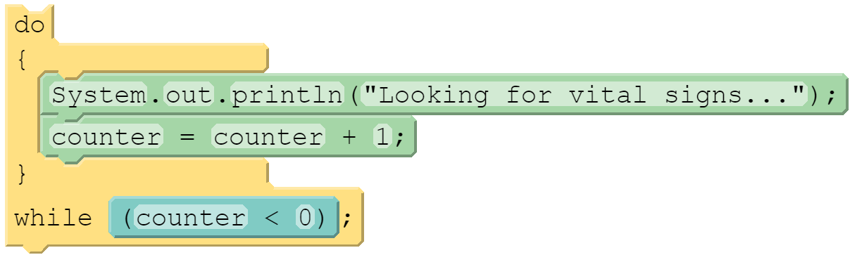
Do-While Loops
A variant of the while loop is the do-while loop. It always executes its code at least once:
11 12 13 14 15 16 17 18 19 20 21 22 23 24 25 26 27 28
int counter = 3;
while (counter > 0)
{
System.out.println("She's not dead yet, Jim.");
counter = counter - 1;
}
System.out.println("Ok, now she's dead.");
do
{
System.out.println("Looking for vital signs...");
counter = counter + 1;
}
while (counter < 0);
System.out.println("Confirmed!");
System.out.println("I'm making a note here – huge success!");
Values
1
2
3
0
int counter
Output
She's not dead yet, Jim.
She's not dead yet, Jim.
She's not dead yet, Jim.
Ok, now she’s dead.
Looking for vital signs...
Confirmed!
I'm making a note here – huge success!

Slide 41
Practice
Write a number guessing game program. Generate a random number between 1 and 10, then keep asking the user for a number until they guess it right
Sample output
I’m thinking of a number between 1 and 10: 4
Nope. Try again: 3
Nope. Try again: 7
Nope. Try again: 2
Nope. Try again: 9
Yup, you got it!

Slide 42
Program Control
“You've got to know when to hold 'em, know when to fold 'em, know when to walk away, know when to run…”
– Kenny Rodgers
Based on slides created for COP3502 by Dr. Jeremiah Blanchard
Modified by Fernando J. Rodríguez

Slide 43
Types of Loops
Indefinite loops: the number of iterations is unknown beforehand
Examples: number guessing game, waiting for specific input
Use while loops and do-while loops
Definite loops: the number of iterations is known beforehand
Examples: number guessing game with limited tries, go through a range of numbers
Use for loops

Slide 44
for Loops
for loops: executes a statement or group of statements a specified number of times based on the given initialization, condition, and update expressions
for (<initialization>; <condition>; <update>)
{
<statements>
}
initialization
condition
false
true
statements
update

Slide 45
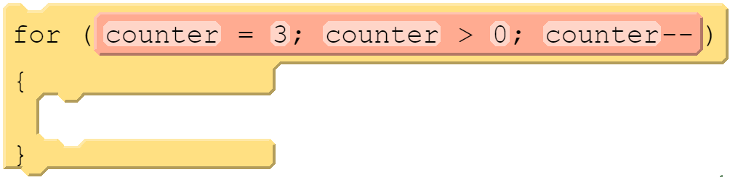
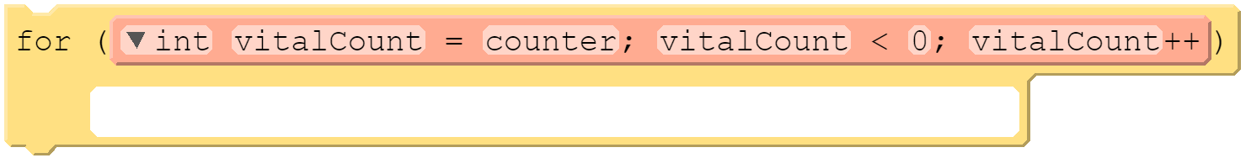
For-Loops
Loops that go across a range of values are called for-loops:
11 12 13 14 15 16 17 18 19 20 21 22 23 24
int counter;
for (counter = 3; counter > 0; counter--)
{
System.out.println("She's not dead yet, Jim.");
}
System.out.println("Ok, now she's dead.");
System.out.println("Looking for vital signs...");
for (int vitalCount = counter; vitalCount < 0; vitalCount++)
System.out.println(“Failed! Looking again...");
System.out.println("Confirmed!");
System.out.println("I'm making a note here – huge success!");
Values
3
2
1
0
int counter
int vitalCount
0
Output
She's not dead yet, Jim.
She's not dead yet, Jim.
She's not dead yet, Jim.
Ok, now she’s dead.
Looking for vital signs...
Confirmed!
I'm making a note here – huge success!

Slide 46
Practice
Write a program that counts from 1 to 10.
Sample output
1
2
3
4
5
6
7
8
9
10

Slide 47
Nested Loops
Sometimes a loop inside of a loop is needed – we call this nesting:
05 06 07 08 09 10 11 12 13 14 15 16 17
System.out.print("What will be the box width and height? ");
Scanner inputPlz = new Scanner(System.in);
int width = inputPlz.nextInt();
int height = inputPlz.nextInt();
for (int hIndex = 0; hIndex < height; hIndex++)
{
for (int wIndex = 0; wIndex < width; wIndex++)
System.out.print("*");
System.out.println("");
}
Output
8 4
What will be the box width and height?
********
********
********
********

Slide 48
Break Statements
Sometimes we may want to break out of a loop without completing it:
07 08 09 10 11 12 13 14 15 16 17 18 19 20 21 22
Scanner inputPlz = new Scanner(System.in);
int input = -1;
while (input != 0)
{
System.out.print("Enter a positive integer (0 to exit): ");
input = inputPlz.nextInt();
if (input < 0)
{
System.out.println("Error: negative number. Terminating.");
break;
}
System.out.println("You entered " + input + ".");
}
System.out.println("Program terminated.");
Output
10
Enter a positive integer (0 to exit):
You entered 10.
Enter a positive integer (0 to exit):
Error: negative number. Terminating.
Program terminated.
-10

Slide 49
Continue Statements
At other times, we might want to continue to the next iteration:
07 08 09 10 11 12 13 14 15 16 17 18 19 20 21 22
Scanner inputPlz = new Scanner(System.in);
int input = -1;
while (input != 0)
{
System.out.print("Enter a positive integer (0 to exit): ");
input = inputPlz.nextInt();
if (input < 0)
{
System.out.println("Error: negative number. Try again.");
continue;
}
System.out.println("You entered " + input + ".");
}
System.out.println("Program terminated.");
Output
-10
Enter a positive integer (0 to exit):
Error: negative number. Try again.
Enter a positive integer (0 to exit):
You entered 0.
Program terminated.
0

Slide 50
Variable Scope
Scope: the part of your program where a variable can be accessed
A variable can be accessed from its declaration to the end of the curly braces ({ }) in which it is defined
public static void main(String[] args)
{
int x = 3;
for (int i = 0; i <= 10; i++)
{
System.out.println(x);
}
}
Scope of x
Scope of i

Slide 51
Variable Scope Implications
Variables without overlapping scope can have the same identifier
for (int i = 1; i <= 100; i++)
{
System.out.print("Hello there");
}
int i = 5;
Variables cannot be declared twice in the same scope
for (int i = 1; i <= 100; i++)
{
int i = 5;
System.out.print("Hello there");
}
Variables cannot be accessed outside of their scope
for (int i = 1; i <= 100; i++)
{
System.out.print("Hello there");
}
i = 5;

Slide 52
Practice
Write a program to determine the largest integer from a set of user input numbers. Ask the user how many numbers they want to compare, then ask for each number; afterwards, print the largest number.
Sample output
How many numbers? 3
Enter a number: 45
Enter a number: 57
Enter a number: 32
The largest number was 57.

